Slide 1
Image-Based Retrieval Augmented Generation (RAG) Relevant to Biodiversity and Taxonomy
Talks & Brainstorms – Apr 30, 2024
Nate Lesperance
Department of Integrative Biology

Slide 2
Presentation Objectives
Introduce Retrieval Augmented Generation (RAG) + initial context of RAG bootcamp project
Introduce project objectives using two-module pipeline
Module 1: Framework for image to text for taxonomy and biodiversity
Module 2: Explore RAG optimizations explored so far
Discuss optimizations and next steps moving forward (immediate and distant)

Slide 3
RAG Basics
Documents
____
____
____
____
____
____
____
____
____
____
____
____
Embedding
Prompt to LLM
Query-Relevant
Document(s)
{context}
{query}
Vectorstore
____
____
____
Embedding
ANSWER
Query

Slide 4
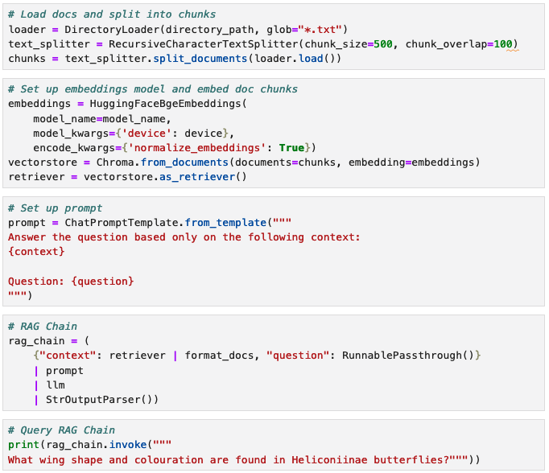
Simple RAG Pipeline Example
Full RAG Pipeline
(minus some imports and helper functions)

Slide 5
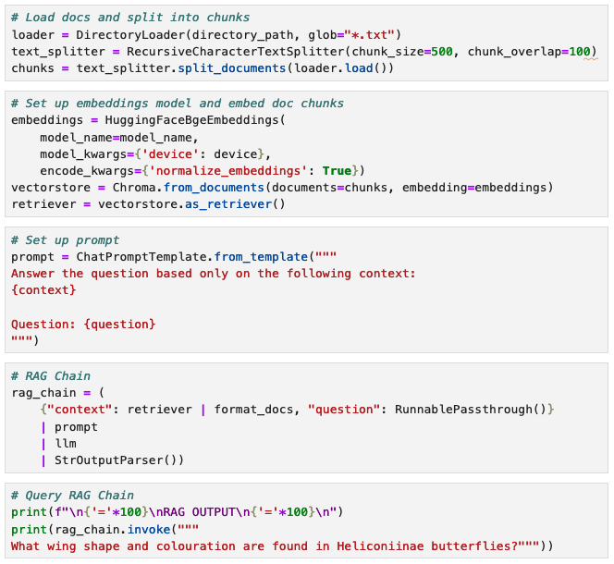
Simple RAG Pipeline Example
Load and split documents into chunks
Import Embedding model
Build Vectorstore from embeddings of chunks

Slide 6
Simple RAG Pipeline Example
Prepare LLM prompt with formattable context and question

Slide 7
Simple RAG Pipeline Example
Prepare RAG Chain
- Query and context piped to LLM

Slide 8
Simple RAG Pipeline Example
Query the RAG Chain
- Ask your question

Slide 9
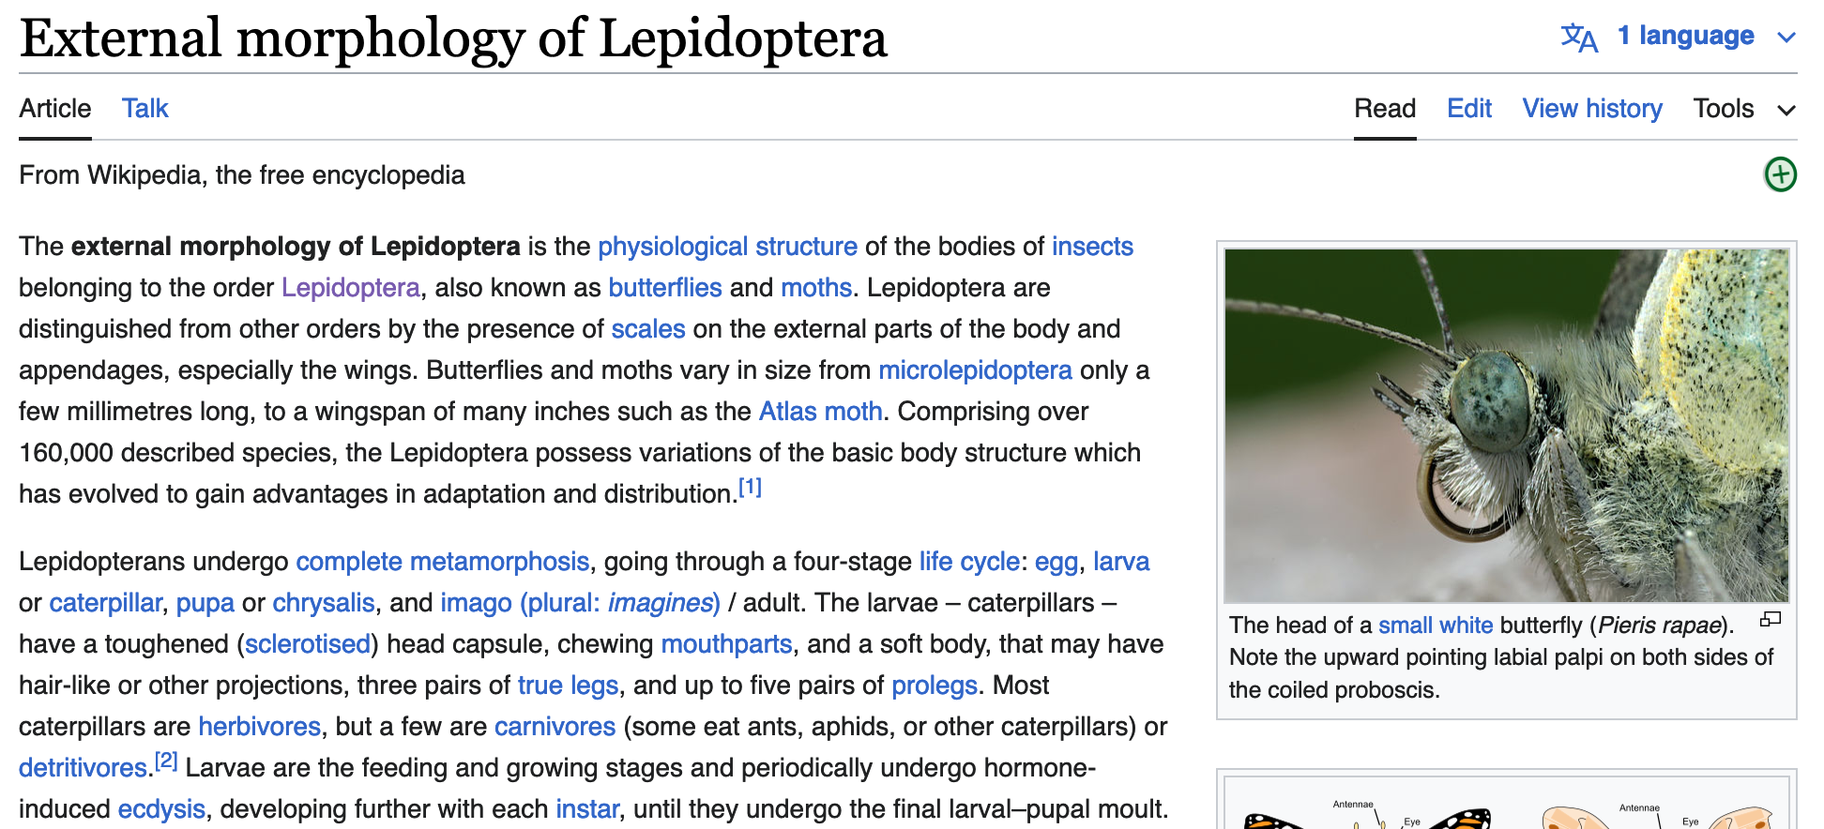
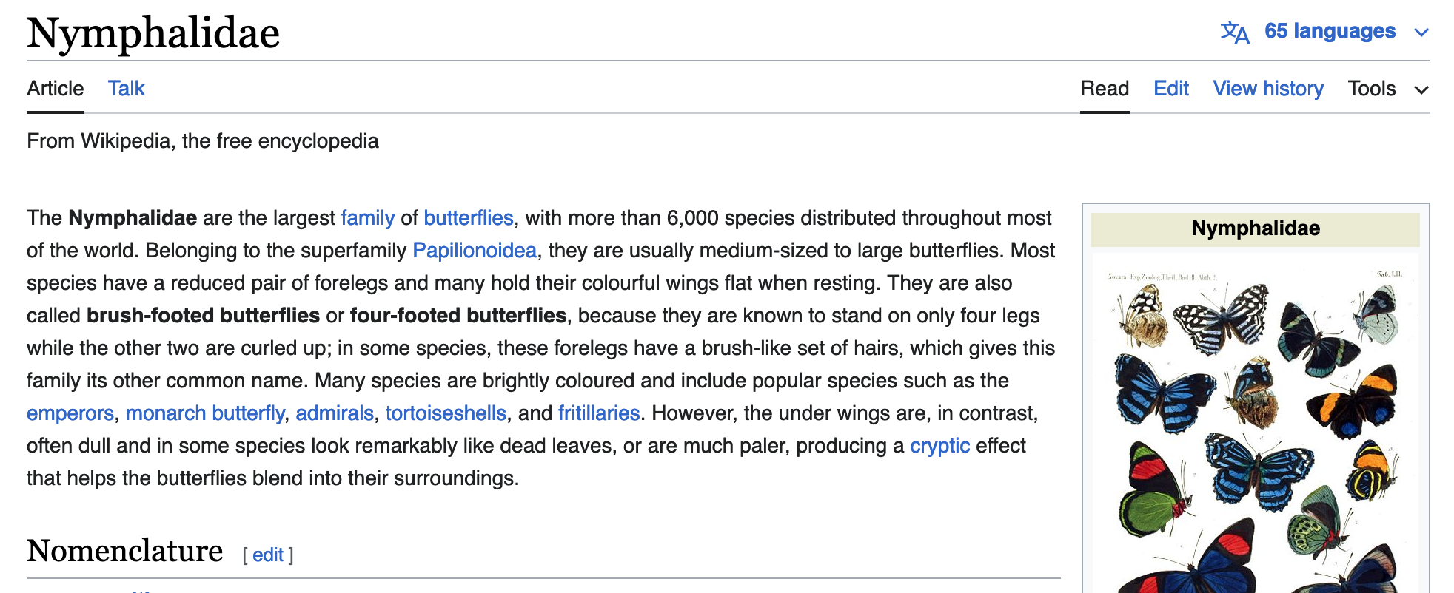
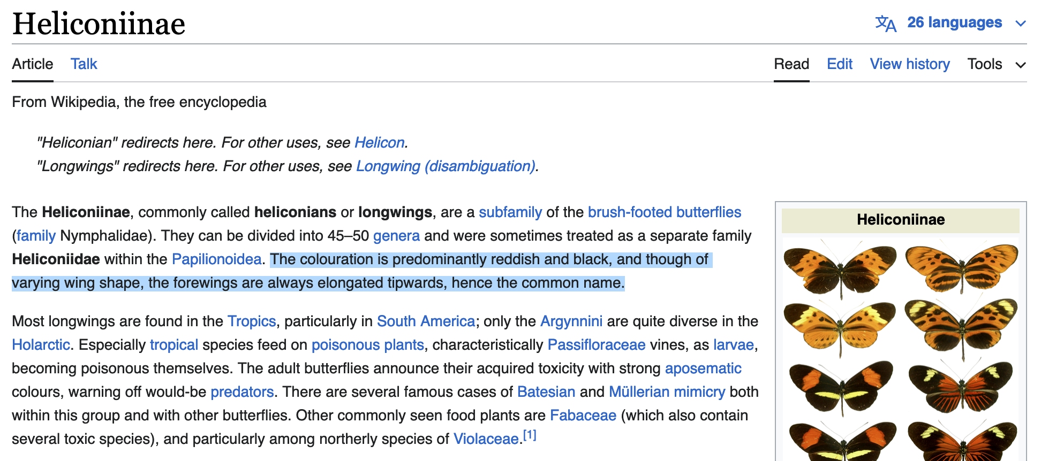
Simple RAG Pipeline Example
Vectorstore from few Wikipedia articles
Relevant Context:
The colouration is predominantly reddish and black, and though of varying wing shape, the forewings are always elongated tipwards, hence the common name.
Context
Query:
What wing shape and colouration are found in Heliconiiae butterflies?
Query

Slide 10
Simple RAG Pipeline Example
Vectorstore from few Wikipedia articles
Result
The answer is Heliconiinae butterflies are predominantly black in colouration and have varying wing shapes, particularly elongated wings towards the tip.
Relevant Context:
The colouration is predominantly reddish and black, and though of varying wing shape, the forewings are always elongated tipwards, hence the common name.
Context
Query:
What wing shape and colouration are found in Heliconiiae butterflies?
How is RAG made image-based?
Query

Slide 11
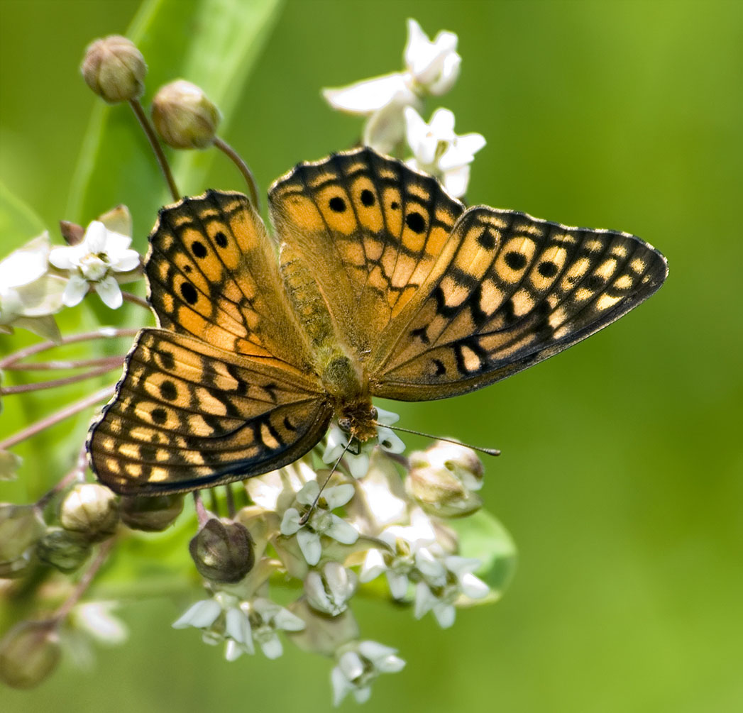
Refined Use-Case: Taxonomic Classification + Biodiversity Knowledge
Module 1
Module 2
Tree of Life Web
Wikipedia
Wikispecies
Scientific
Journals
Web search?
Biodiversity Heritage Library
Others?
Image Captioner
Descriptive
Caption
RAG Pipeline
Output:
Taxonomic Classification
Biodiversity Knowledge

Slide 12
Refined Use-Case: Taxonomic Classification + Biodiversity Knowledge
Result
Based on the information provided, the organism you most likely have in the image is a butterfly from the genus Euptoieta.
Although I don't have an image to visually confirm this, the description you've provided aligns with the common characteristics of the Euptoieta genus, particularly Euptoieta hegesia, also known as the variegated fritillary or the banded fritillary.
Within the context of the information you've provided, here's why Euptoieta is a suitable candidate:
1. Wing color and pattern: Euptoieta butterflies have distinctive brown and black wings with white or yellow bands, which matches the description of the wing color and pattern seen in your image.
2. Floral preference: Your description indicates that the butterfly was seen perching on a white flower, which is consistent with the floral preferences of Euptoieta species. They are often found on white or yellow flowers, especially those in the umbellifer family.
3. Range and habitat: Different Euptoieta species are found in various regions, and some are common in suburban areas
True label: Euptoieta claudia
Image
Text
MODULE 1
Image Captioner
MODULE 2
RAG Pipeline

Slide 13
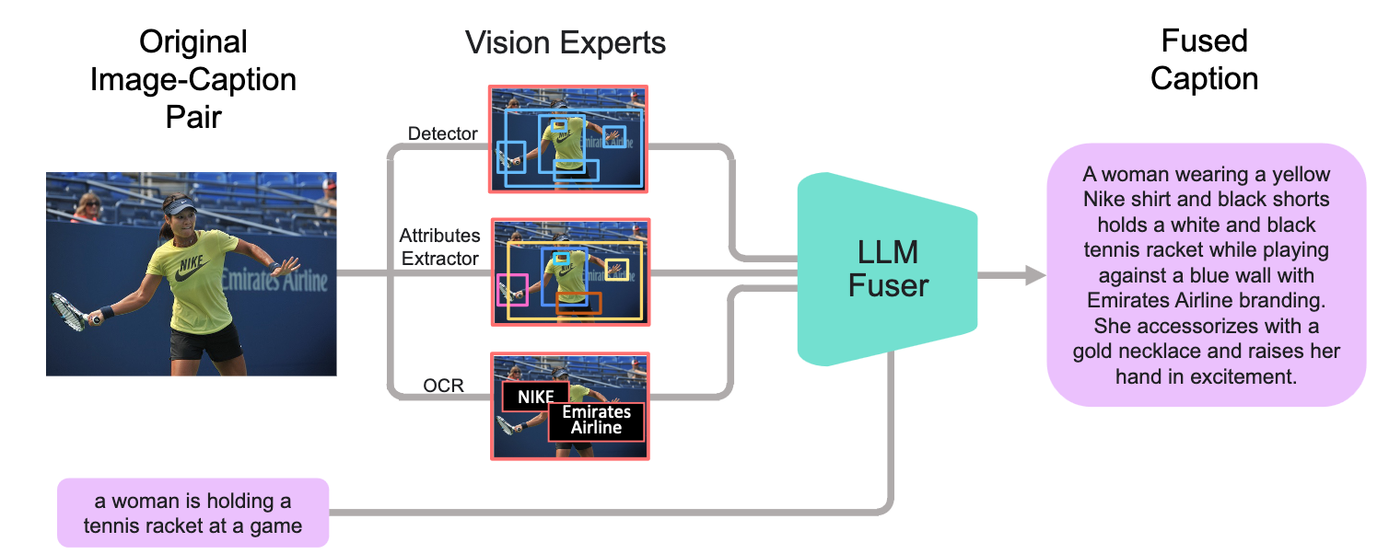
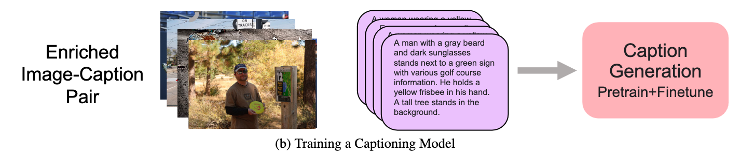
Module 1: Image Captioner
FuseCap
Framework
Captions with Vision Experts into LLM
-> Fused Caption
Fine-tune the Captioner based on Fused Captions
Notes:
Pics sourced from Rotstein et al, 2023 - https://rotsteinnoam.github.io/FuseCap/

Slide 14
Module 1: Image Captioner
?
A butterfly with brown, black and orange wings and a pattern of black spots and black streaks on the upper side of the wing, sitting on a cluster of white flowers with compound umbels
An orange butterfly sitting on white flowers
Object detection?
Biologically-relevant morphological attribute detectors?

Slide 15
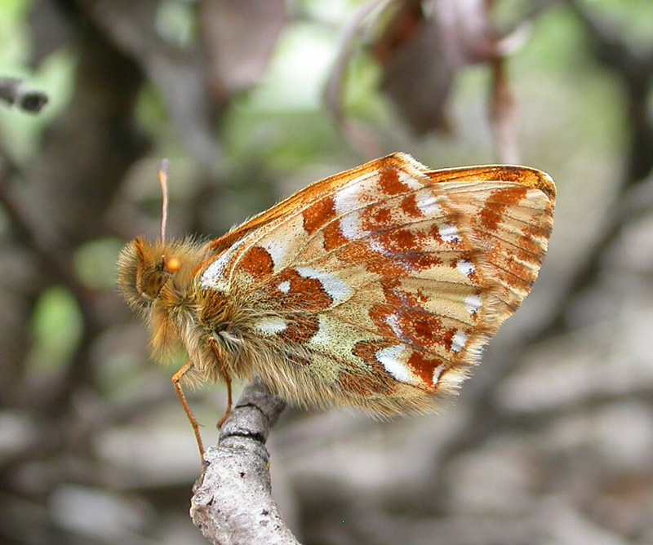
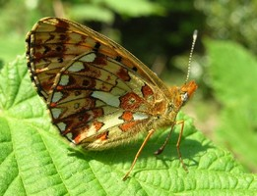
Module 1: Image Captioner
A butterfly with brown, black and orange wings and a pattern of black spots and black streaks on the upper side of the wing, sitting on a cluster of white flowers with compound umbels
A butterfly with brown, black and orange wings and a pattern of black spots and black streaks on the upper side of the wing, sitting on a cluster of white flowers with compound umbels
A butterfly with brown, black and orange wings and a pattern of black spots and black streaks on the upper side of the wing, sitting on a cluster of white flowers with compound umbels
A butterfly with brown, black and orange wings and a pattern of black spots and black streaks on the upper side of the wing, sitting on a cluster of white flowers with compound umbels
FuseCap finetuning with A100 GPUs x8
Image-taxonomy Dataset: Tree-of-Life 10M (iNat-21 backup)

Slide 16
Module 2: RAG Pipeline
txt Documents
PDF Documents
____
____
____
____
____
____
Building Vectorstore
- Parsing PDFs and txt files with metadata
- More robust embeddings model
- Exploring FAISS and ChromaDB
____
____
____
____
____
____
____
____
____
____
____
____
____
____
____
____
____
____
Embedding
Prompt to LLM
Query-Relevant
Document(s)
{context}
{query}
Vectorstore
____
____
____
Embedding
ANSWER
Query

Slide 17
Module 2: RAG Pipeline
txt Documents
PDF Documents
____
____
____
____
____
____
Building Vectorstore
- Parsing PDFs and txt files with metadata
- More robust embeddings model
- Exploring FAISS and ChromaDB
____
____
____
____
____
____
____
____
____
____
____
____
____
____
____
____
____
____
Embedding
Prompt to LLM
Query-Relevant
Document(s)
{context}
{query}
Vectorstore
____
____
____
Embedding
ANSWER
Query

Slide 18
Module 2: RAG Pipeline
PDF and txt Documents
____
____
____
____
____
____
Building Vectorstore
- Parsing PDFs and txt files with metadata
- More robust embeddings model
- Exploring FAISS and ChromaDB
____
____
____
____
____
____
____
____
____
____
____
____
____
____
____
____
____
____
New
Embedding
Prompt to LLM
Query-Relevant
Document(s)
{context}
{query}
Vectorstore
New
Embedding
____
____
____
Query
ANSWER

Slide 19
Module 2: RAG Pipeline
PDF and txt Documents
____
____
____
____
____
____
Building Vectorstore
- Parsing PDFs and txt files with metadata
- More robust embeddings model
- Exploring FAISS and ChromaDB
____
____
____
____
____
____
____
____
____
____
____
____
____
____
____
____
____
____
New
Embedding
Prompt to LLM
Query-Relevant
Document(s)
{context}
{query}
Vectorstore
New
Embedding
____
____
____
Query
ANSWER

Slide 20
Module 2: RAG Pipeline
PDF and txt Documents
____
____
____
____
____
____
Improved Querying
- MultiQuery using LLM
____
____
____
____
____
____
____
____
____
____
____
____
____
____
____
____
____
____
New
Embedding
Prompt to LLM
{context}
{query}
Query-Relevant
Unique Documents
Vectorstore
__
____
Query A
____
____
____
____
____
____
Query
LLM
Query B
__
____
ANSWER
Query C
__
____

Slide 21
Module 2: RAG Pipeline
PDF and txt Documents
____
____
____
____
____
____
Improved Retrieval
- Compressing and reranking retrieved documents
____
____
____
____
____
____
____
____
____
____
____
____
____
____
____
____
____
____
New
Embedding
Prompt to LLM
{context}
{query}
Query-Relevant
Unique Documents
Vectorstore
__
____
Query A
____
____
____
____
____
____
____
____
____
Query
LLM
Query B
__
____
____
____
____
ANSWER
Query C
__
____
Compressed +
Reranked

Slide 22
Module 2: RAG Pipeline
PDF and txt Documents
____
____
____
____
____
____
Improved Output
- Chain of thought system prompt engineering
- Gradio interface
____
____
____
____
____
____
____
____
____
____
____
____
____
____
____
____
____
____
ANSWER
New
Embedding
Prompt to LLM
Use
{context}
in
Step by Step
Thought Process
to answer
{query}
Query-Relevant
Unique Documents
Vectorstore
__
____
Query A
____
____
____
____
____
____
____
____
____
Query
LLM
Query B
__
____
____
____
____
Query C
__
____
Compressed +
Reranked

Slide 23
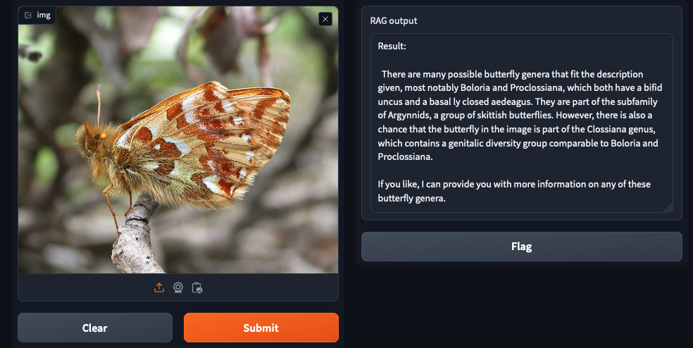
Module 2: RAG Pipeline
PDF and txt Documents
____
____
____
____
____
____
Improved Output
- Chain of thought system prompt engineering
- Gradio interface
____
____
____
____
____
____
____
____
____
____
____
____
____
____
____
____
____
____
ANSWER
New
Embedding
Prompt to LLM
Use
{context}
in
Step by Step
Thought Process
to answer
{query}
Query-Relevant
Unique Documents
Vectorstore
__
____
Query A
____
____
____
____
____
____
____
____
____
Query
LLM
Query B
__
____
____
____
____
Query C
__
____
Compressed +
Reranked

Slide 24
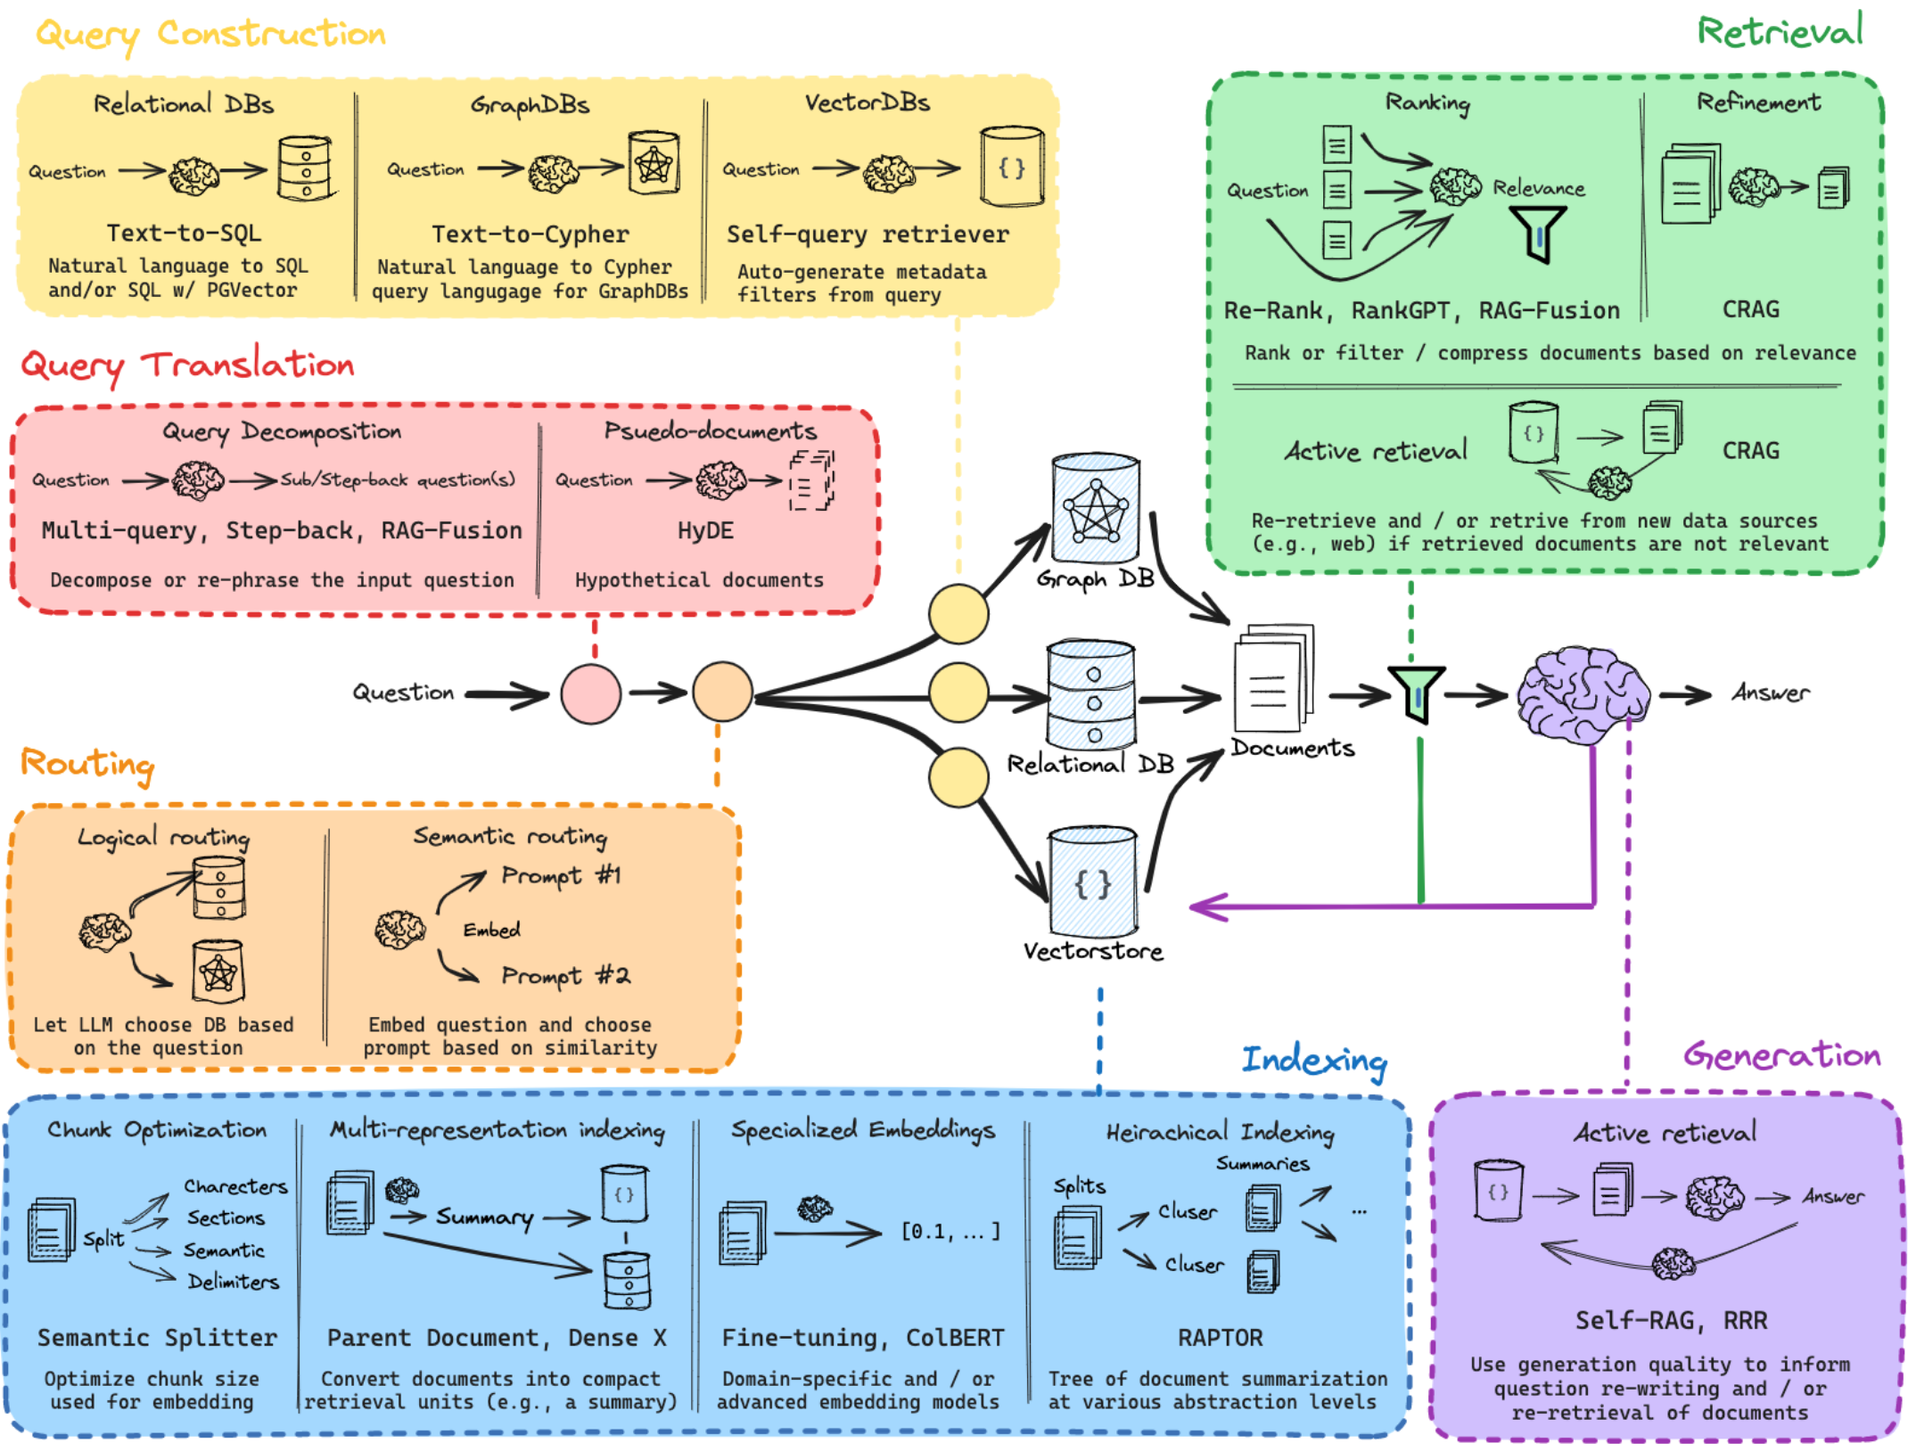
Possible RAG Extensions
Lots of optimization options
Major Roadblocks:
- Web-scraping
- Evaluation
Notes:
Pic sourced from https://github.com/langchain-ai/rag-from-scratch

Slide 25
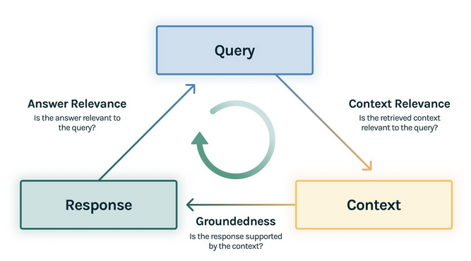
Next Steps (Sooner)
Immediate need for evaluation metrics (RAG Triad by TruLens)
Larger vectorstore:
- Building multiple vectorstores for more directed querying
- Integrate metadata filters

Slide 26
Next Steps (Later)
MODULE 1: Image Captioner
Biologically-relevant fused captions
Pretraining and finetuning captioner
MODULE 2: RAG Pipeline
Integrating relational database (BOLD)?
Additional RAG optimizations
Full Pipeline:
Evaluation
- Taxonomic classification compared to benchmarks?
- How evaluate biodiversity-relevant knowledge?
Interactivity
- Chat integration?

Slide 27
Summary
Need for image-based classification paired with knowledge relevant to biodiversity
RAG is powerful tool to leverage LLMs and rich text-based biodiversity databases
Project still early in development but results-driven by nature of RAG and bootcamp
More research needed in prep for training image captioner
Evaluation metrics will help measure and guide improvement

Slide 28
Thank you ☺
Special thanks to Graham and Sujeevan for their hard work on this project and for including me!

